Slide 1
Planning
Principles of Management

Slide 2
Material covered will include:
Defining the nature and purposes of planning.
Classifying the types of goals organisations might have and the plans they use.
Compare and contrast approaches to goal-setting and planning.
Discussion on contemporary issues in planning.

Slide 3
Planning – Video Clips
Planning ( Lecture) (10.02 mins) (Management Planning #13)
Fly to the sun strategic planning animated video (2.20 mins)

Slide 4


What Is Planning?
Planning involves;
defining the organisation’s goals,
establishing an overall strategy for achieving those goals,
and developing plans to integrate and coordinate work activities.
The term Planning in this section, refers to ‘formal’ planning, which are …
Specific goals covering a specific time period,
Written and shared with organisational members.
Planning is concerned with both the ends (what) and the means (how), an organisation will achieve its goals.

Slide 5



Slide 6

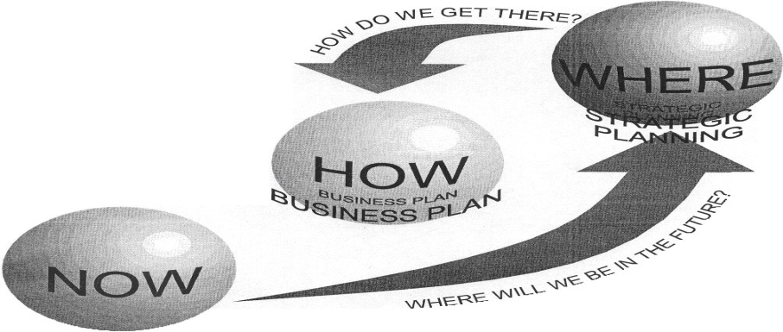
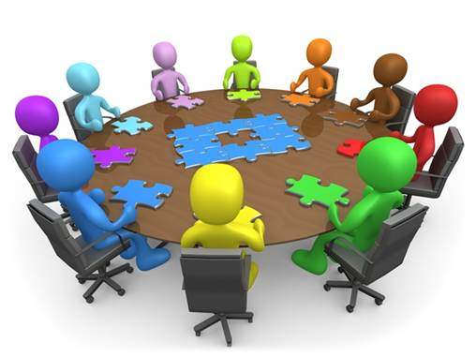



Slide 7

Why do managers plan?
Planning serves a number of significant purposes.
Planning gives direction to managers and non managers of an organisation.
Planning reduces uncertainty.
Planning minimises waste and redundancy.
Planning establishes goals or standards used in controlling.

Slide 8
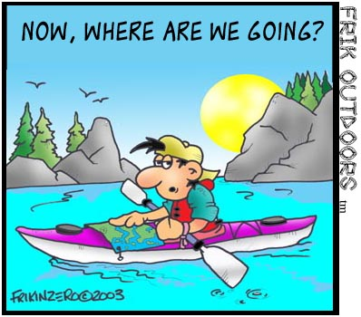
Why do managers plan? (cont.)
Planning provides direction to managers and non managers alike.
When employees know what their organisation or work unit is trying to accomplish and what they must contribute to reach goals, they can coordinate their activities, cooperate with each other, and do what it takes to accomplish those goals.

Slide 9


Why do managers plan? (cont.)
Planning reduces uncertainty by forcing managers to look ahead,
Anticipate change, consider the impact of change, and develop appropriate responses.
Although planning will not eliminate uncertainty, managers plan so they can respond effectively.

Slide 10
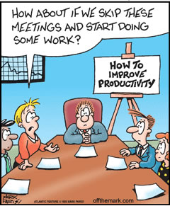
Why do managers plan? (cont.)
Planning minimises waste and redundancy.
When work activities are coordinated around plans, inefficiencies become obvious and can be corrected or eliminated.

Slide 11
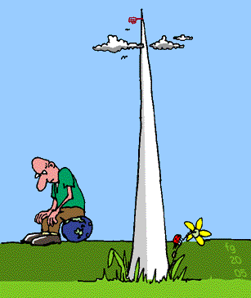
Why do managers plan? (cont.)
Planning establishes the goals or standards used in controlling.
When managers plan, they develop goals and plans.
When they control, they see whether the plans have been carried out and the goals met.

Slide 12


Planning and Performance
Although organisations that use formal planning do not always outperform those that do not plan,
Numerous studies shown generally positive relationships between planning and performance.
(Ghobadian, A., O’Regan, N. Thomas, H. and Liu, J. , 2008)
Formal planning is associated with:
Positive financial results - higher profits, higher return on assets,.
Effective planning and implementation affects performance more than the extent of, or amount of planning (… how much planning is done)

Slide 13


Planning and Performance
The external environment can reduce the impact of planning on performance.
In studies where formal planning did not lead to higher performance, the external environment often was the culprit.
When external forces – such as governmental regulations or powerful labor unions - constrain managers’ options, it reduces the impact planning has on an organisation’s performance.
Finally, the planning-performance relationship seems to be influenced by the planning time frame.
It seems that at least 4 years of formal planning is required before it begins to affect performance.

Slide 14


Goals & Plans
Planning is often called the primary management function because it establishes the basis for all other functions.
Planning involves two important elements: Goals and Plans.
As managers plan, they develop both goals and plans.

Slide 15

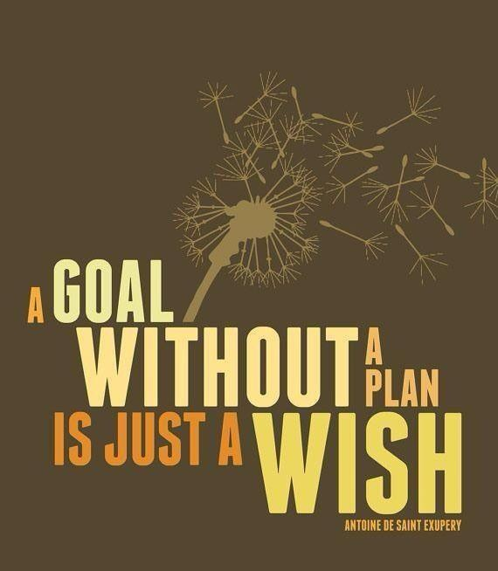

Slide 16
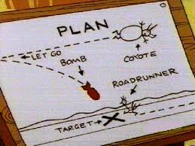
Goals & Plans
Goals (objectives) – are “desired outcomes or targets” for individuals groups, or entire organisations
(Molz, 1987)
They guide management decisions and form the criterion against which work results are measured.
That is why they are often described as the essential elements of planning.
You have to know the desired target or outcome before you can establish plans for reaching it.
Plans - are documents that outline how goals are going to be met.
They usually include resource allocations, schedules, and other necessary actions to accomplish the goals.

Slide 17

Types of Goals: Strategic & Financial
It is possible to classify most company’s goals as either ‘Strategic’ or ‘Financial’.
Strategic Goals - related to the performance of the firm relative to factors in its external environment (e.g., competitors).
An example of a strategic goal - from Bloomberg L.P.: “We want to be the world’s most influential news organisation.”
(Clifford and Creswell, 2009),
Financial Goals - related to the expected internal financial performance of the organisation.
E.g. McDonald’s states that it’s financial targets are 3 to 5 percent average annual sales and revenue growth, 6% to 7% average annual operating income growth, and returns on invested capital in the high teens. (McDonalds, 2010)

Slide 18

Types of Goals: Stated & Real
Stated Goals V’s Real Goals
Stated goals are official statements of what an organisation says and what it wants its various stakeholders to believe its goals are.
Real goals are those that an organisation actually pursues, as defined by the actions of its members.

Slide 19
Types of Goals: Stated & Real
Stated goals - official statements of what an organisation says, and what it wants its various stakeholders to believe, its goals are.
However, …. stated goals - which can be found in an organisation’s charter, annual report, public relations announcements, or in public statements made by managers, - are often conflicting and influenced by what various stakeholders think organisations should do.
Real goals - goals that an organisation actually pursues, as defined by the actions of its members.
If you want to know an organisation’s real goals; those goals an organisation actually pursues, … observe what organisational members are doing.
Actions define priorities.

Slide 20
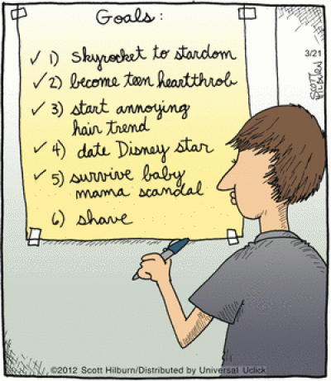
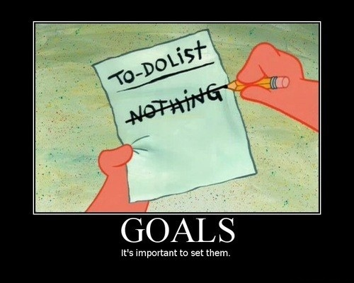
Stated Goals V’s Real Goals

Slide 21

Types of Plans
Plans - are documents that outline how goals are going to be met.
They usually include resource allocations, schedules, and other necessary actions to accomplish the goals.
The most popular ways to describe organisational plans;
are breadth (strategic versus operational),
time frame (short term versus long term),
specificity (directional versus specific),
frequency of use (single use versus standing).

Slide 22
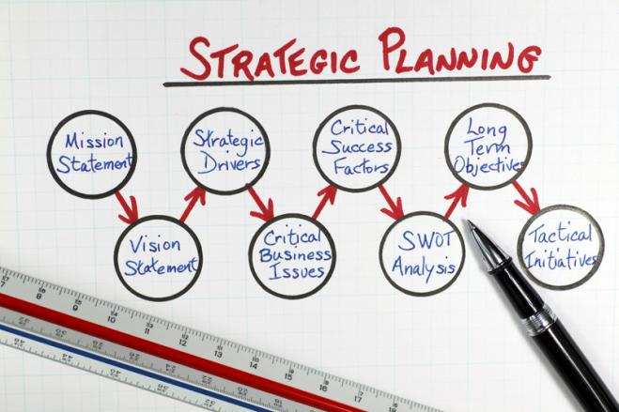
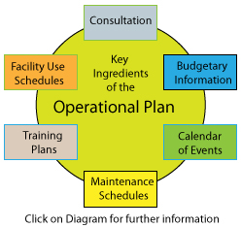
Breadth: Strategic V’s Operational
Strategic Plans …
Long term plans,
apply to the entire organisation,
seek to establish the organisation's overall goals,
and seek to position the organisation in terms of its environment.
Operational Plans ….
Short term plans,
Plans that encompass a particular operational area of the organisation,
that specify the details of how the overall goals are to be achieved.

Slide 23

Time Frame: Short V’s Long
Short-term plans - plans covering 1 year or less.
Long-term plans - plans with a time frame beyond 3 years.
Any time period in between would be an intermediate plan.
Although these time classifications are fairly common, an organisation can use any planning time frame it wants.

Slide 24

Specificity: Specific V’s Directional
Specific plans – plans that are clearly defined and leave no room for interpretation.
A specific plan - states its objectives in a way that eliminates ambiguity and problems with misunderstanding.
Directional plans – plans that are flexible and set out general guidelines
They provide focus but do not lock managers into specific goals or courses of action.
E.g. President of Motown Records, has a simple goal “to sign great artists”

Slide 25

Frequency of Use: Single V’s Standing
Some plans that managers develop are ongoing while others are used only once.
Single-use plan - a one-time plan specifically designed to meet the needs of a unique situation
E.g. When Coca Cola was closing down its Dublin manufacturing plant, it developed a single use pan to manage the process.
When Walmart wanted to expand its shops in China, top executives formed a single use plan as a guide.
Standing plans - ongoing plans that provide guidance for activities performed repeatedly
Include policies, rules & procedures
E.g. an anti bullying policy in a school, a recruitment & selection procedure in an organisation.

Slide 26
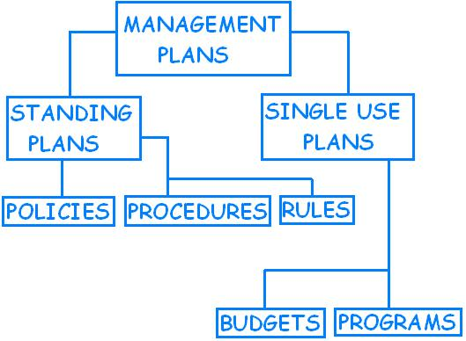
Single & Standing Plans

Slide 27
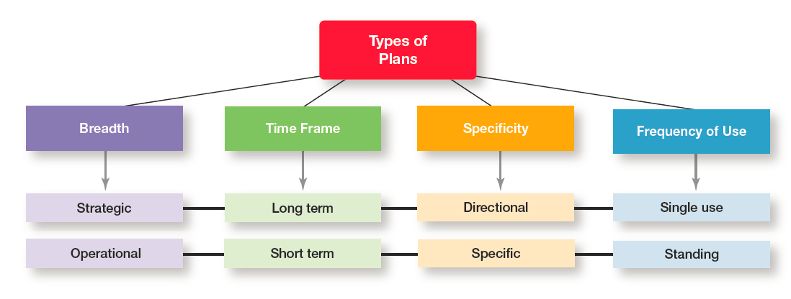
Types of Plans - Plans are not Independent (Source: Robbins & Coulter, 2014)
Strategic plans are usually - long term, directional, and single use
Operational plans are usually - short term, specific, and standing.

Slide 28
Setting Goals & Developing Plans

Slide 29
Traditional Goal Setting
Traditional goal setting is an approach to setting goals in which goals are set at the top level of the organisation and then broken into sub-goals for each level of the organisation.
Traditional goal setting assumes that top managers know what is best because of their ability to see the “big picture.”
Employees are to work to meet the goals for their particular area of responsibility.
This traditional approach requires that goals must be made more specific as they flow down to lower levels in the organisation.
In striving to achieve specificity, however, objectives sometimes lose clarity and unity with goals set at a higher level in the organisation.

Slide 30
The Downside of Traditional Goal-Setting
A problem with traditional goal-setting is that when top managers define the organisation’s goals in broad terms - such as achieving “sufficient” profits or increasing “market leadership”.
These ambiguous goals have to be made more specific as they flow down through the organisation.
Managers at each level define the goals and apply their own interpretations and biases as they make them more specific.
However, what often happens is that clarity is lost as the goals make their way down from the top of the organisation to lower levels.

Slide 31
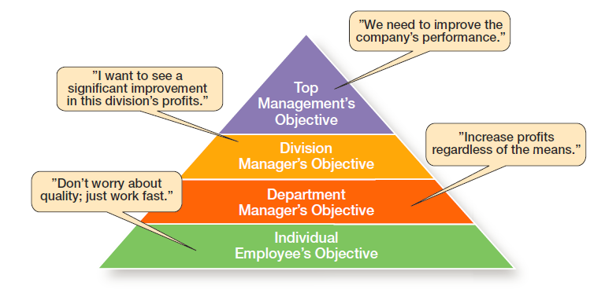
The Downside of Traditional Goal-Setting (Source: Robbins & Coulter, 2014)

Slide 32


Goal-Setting

Slide 33
Traditional Goal Setting
When the hierarchy of organisational goals is clearly defined it forms an integrated network of goals, or a means-ends chain.
in which the accomplishment of goals at one level, serves as the means for achieving the goals, or ends, at the next level.
Higher-level goals (or ends) are linked to lower-level goals,
In other words, the goals achieved at one level become the means to reach the goals (ends) at the next level.,….
….. and on up through the different organisational levels.
That is how traditional goal-setting is supposed to work.

Slide 34

Management by Objectives (MBO)
Instead of using traditional goal-setting, many organisations use management by objectives (MBO),
A process of setting mutually agreed-upon goals and using those goals to evaluate employee performance.
MBO programs have four elements:
goal specificity,
participative decision making,
an explicit time period,
and performance feedback.
Instead of using goals to make sure employees are doing what they are supposed to be doing, MBO uses goals to also motivate staff.
The appeal is that it focuses on employees working to accomplish goals they have had a hand in setting.
Studies have shown that MBO can increase employee performance and organisational productivity.

Slide 35
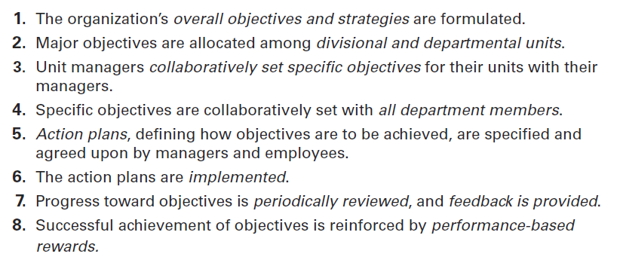
Steps in a Typical MBO Program (Source: Robbins & Coulter, 2014)

Slide 36
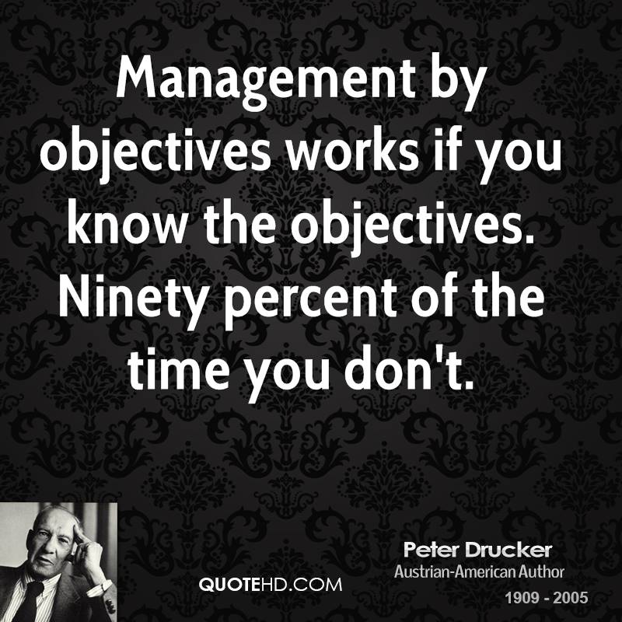

Slide 37
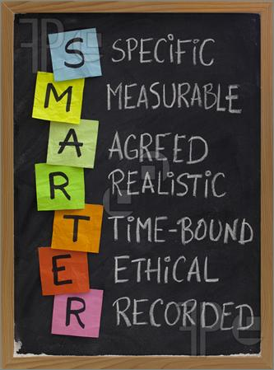
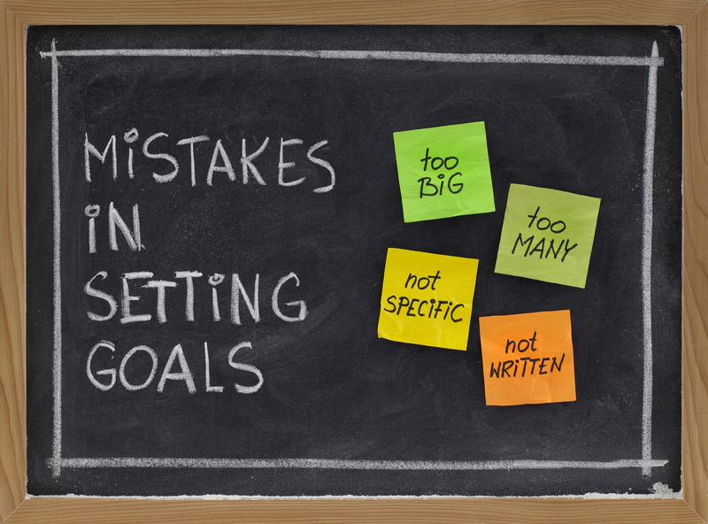
Five Steps in Goal-Setting
Review the organisation’s mission, (the purpose of the organisation).
Evaluate available resources.
Determine the goals individually or with input from others.
Write down the goals and communicate them to all who need to know.
Review results and whether goals are being met, Make changes as needed.

Slide 38
5 Steps in Goal-Setting
1. Review the organisation’s mission, or purpose.
A mission is a broad statement of an organisation’s purpose that provides an overall guide to what organisational members think is important.
Managers should review the mission before writing goals, because goals should reflect that mission.
2. Evaluate available resources. A manager does not want to set goals that are impossible to achieve given your available resources.
Even though goals should be challenging, they should be realistic.
If the resources a manager has to work with will not allow them to achieve a goal no matter how hard one tries, or how much effort is exerted, a manager should not set that goal.

Slide 39
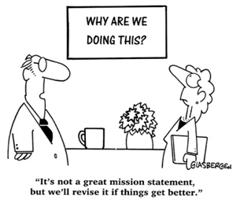

Slide 40
5 Steps in Goal-Setting (cont.)
3. Determine the goals individually or with input from others.
The goals reflect desired outcomes and should be congruent with the organisational mission and goals in other organisational areas.
These goals should be measurable, specific, and include a time frame for accomplishment.
4. Write down the goals and communicate them to all who need to know.
Writing down and communicating goals forces people to think them through.
The written goals also become visible evidence of the importance of working toward something.

Slide 41
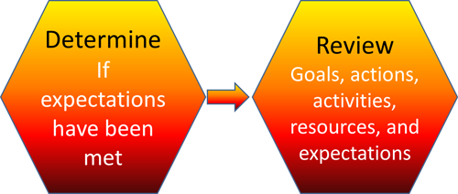
5 Steps in Goal-Setting (cont.)
5. Review results and whether goals are being met.
If goals are not being met, change them as needed.
Once the goals have been established, written down, and communicated, a manager is ready to develop plans for pursuing the goals.

Slide 42

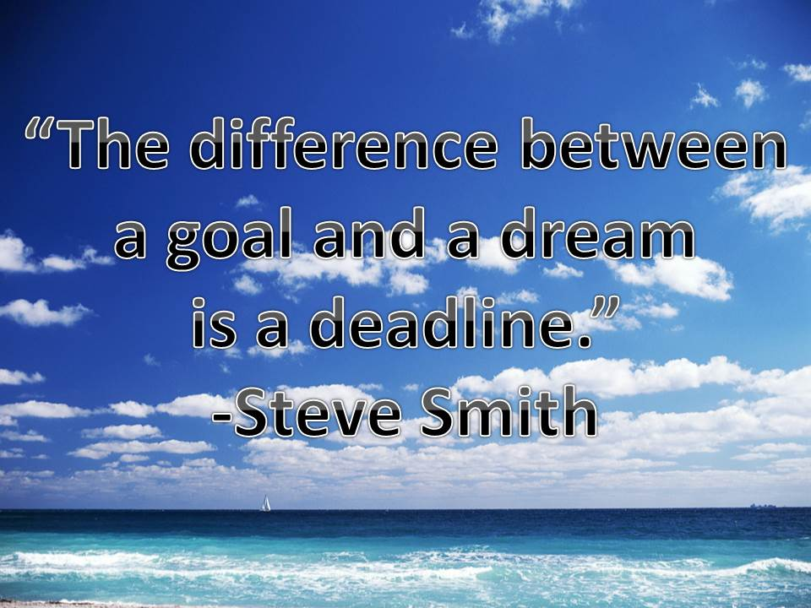
Characteristics of Well-Written Goals (Source: Drucker, 1996)
1. Written in terms of outcomes
2. Measurable and quantifiable
3. Clear as to a time frame
4. Challenging yet attainable
5. Written down
6. Communicated to all organisational members

Slide 43
Developing Plans

Slide 44
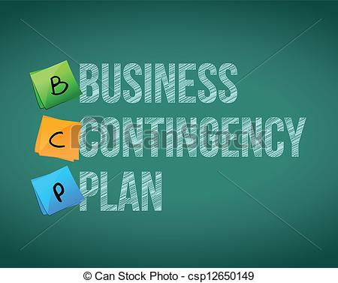
Contingency Factors in Planning
The process of developing plans is influenced by three contingency factors and by the particular planning approach used by the organisation.
The three contingency factors affect the choice of plans:
1. Managers level in the organisation,
2. Degree of environmental uncertainty,
3. Length of future commitments
(Bresser & Bishop, 1983)

Slide 45
Contingency Factors in Planning
1. Manager’s Level in the Organisation
(see next slide, Robbins & Coulter, 2014)
Operational planning usually dominates the planning activities of lower-level managers.
As managers move up through the levels of the organisation, their planning becomes more strategy oriented.

Slide 46
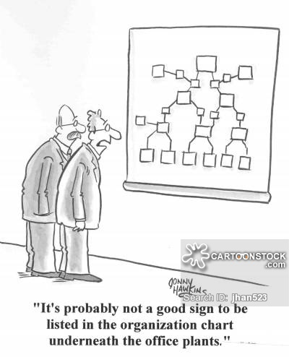

Slide 47
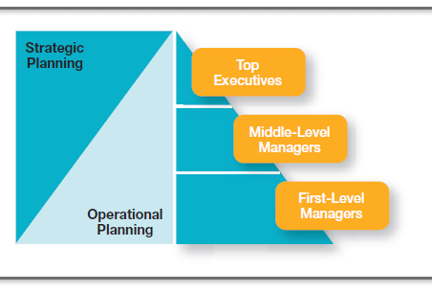
Planning and Organisational Level (Source: Robbins & Coulter, 2014)
Shows the relationship between a manager’s level in the organisation and the type of planning done.
Lower-level managers do operational planning while upper-level managers do strategic planning.

Slide 48
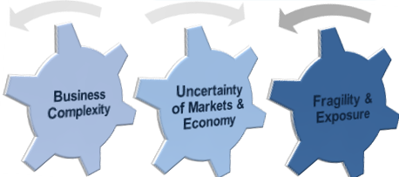
Contingency Factors in Planning
2. Degree of Environmental Uncertainty
The higher the level of environmental uncertainty, …..
the more directional plans should be,
with emphasis placed on the short term,
plans should be specific, but flexible,
managers must be prepared to rework and amend plans,
At times, they may even have to abandon the plans
E.G. Continental Airlines (before its merger with United Airlines) the CEO & management team established a specific goal of focusing on what the customer wanted most - on time flights,
…. because of the high level of uncertainty the management team identified a “destination but not a flight plan”,
and changed plans as necessary to achieve the goal of on time service.

Slide 49
Contingency Factors in Planning
3. Length of Future Commitments
plans should extend far enough to meet those commitments made today (or when ever the plans were developed),
Planning for too long or short a time period is inefficient and ineffective
AT& T and iPhone - good example of understanding commitment concept.
When AT & T negotiated exclusive rights to support iPhone on its wireless network in June 2007 both Apple & AT& T vastly underestimated the phones popularity,
E.g. from 2011 to 2012 - almost 22 million iPhones sold.
AT& T’s network could not handle the traffic
“we missed our usage estimates “ - AT & T chief strategy officer
In becoming the primary provider for the iPhone, AT& T “committed” to all future expenses generated by that planned decisions, …... they have to live with the consequences – both good and bad.

Slide 50
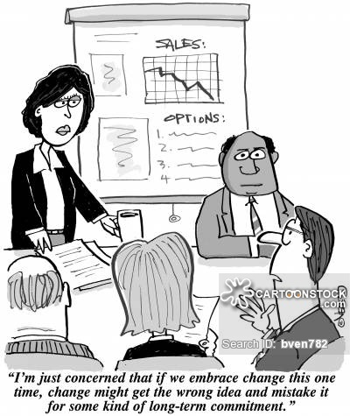

Slide 51
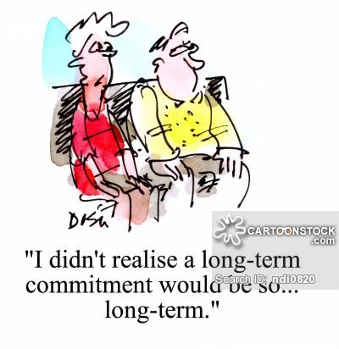

Slide 52
Some facts about planning (Source: American Management Association, 2010)
51% of managers said they were approaching planning differently by using more business scenarios and data driven approaches.
47% of managers said their organisations projects always or often meet their goals.
19% if executives said that planning was an important skill
7% of information executives said they have no plan for disaster recovery.
75% of managers said their company’s planning approach was not working.
69% of managers said teams are not given enough resources to complete projects.

Slide 53
Approaches to Planning
In the traditional approach, planning is done entirely by top-level managers often are assisted by a formal planning department
Formal planning department - a group of planning specialists whose sole responsibility is helping to write organisational plans
Under the traditional approach,
plans developed by top-level managers flow down through other organisational levels,
much like the traditional approach to goal-setting.
As they flow down through the organisation, the plans are tailored to the particular needs of each level.

Slide 54
Approaches to Planning
Although the traditional approach to planning makes managerial planning thorough, systematic, and coordinated, …...
……all too often the focus is on developing “the plan” - a thick binder (or binders) full of meaningless information that is stuck on a shelf and never used by anyone for guiding or coordinating work efforts.
Another approach to planning is to involve more members of the organisation in the planning process.
In this approach, plans are not handed down from one level to the next, but are developed by organisational members at various levels to meet their specific needs.

Slide 55
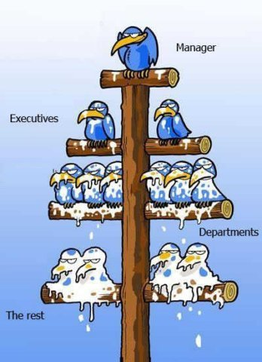
Traditional Top Down Approach to Planning ??!!

Slide 56

Contemporary Issues in Planning
How Can Managers Plan Effectively in Dynamic Environments?
How Can Managers Use Environmental Scanning?

Slide 57

How Can Managers Plan Effectively in Dynamic Environments?
The external environment is continually changing.
Dynamic environments are more the norm than the exception.
E.g. Cloud computing storage is revolutionising many industries from financial services to health care and engineering
Social network sites are used by organisations to connect with customers and employees.
In an uncertain environment, managers should develop plans that are specific, but flexible (not set in stone!) ……
Although this may seem contradictory, it’s not!
Planning is an ongoing process and maintaining flexibility is important.

Slide 58

How Can Managers Plan Effectively in Dynamic Environments?
Even though the environment is highly uncertain, it is critical to continue formal planning.
Managers ‘learn to plan’ and the quality of their planning improves the more they do it.
(Brews & Hunt, 2009)
Persistence in planning contributes to significant performance improvement.
The plans serve as a road map although the destination may change,….
…. And, ……they should be ready to change directions if environmental conditions warrant.

Slide 59
How Can Managers Plan Effectively in Dynamic Environments? – Example - Wipro
2002 - Wipro Limited was “an anonymous conglomerate selling cooking oils & personal computers in India” (Riberio, 2009)
2012 it is a $7.5 billion a year global company with most business coming form IT services.
Now Wipro competes with Accenture, Hewlett-Packard, IBM and big US accountancy firms
Wipro employees are knowledgeable & skilled - they also play an important role in the company’s planning
Because IT services industry is constantly changing – the employees are taught to analyse situations & to define the scale and scope of a clients problem in order to offer the best solution.
The employees are on the front line with the customer – it is their responsibility to establish what to do and how to do it.

Slide 60

How Can Managers Use Environmental Scanning?
A manager’s analysis of the external environment may be improved by ‘Environmental Scanning’.
Environmental Scanning - is the screening of information to detect emerging trends.
CEO of PepsiCo, Indra Nooyi, visited a Chinese family in Shanghai, four generations crammed it their apartment - and asked them questions about China’s rapidly developing economy, their shopping habits, and how they feel about western brands.
This ‘environmental scanning’ – up close and personal will help establish PepsiCo’s future goals and plans.
(Fairclough and Bauerlein, 2009)

Slide 61
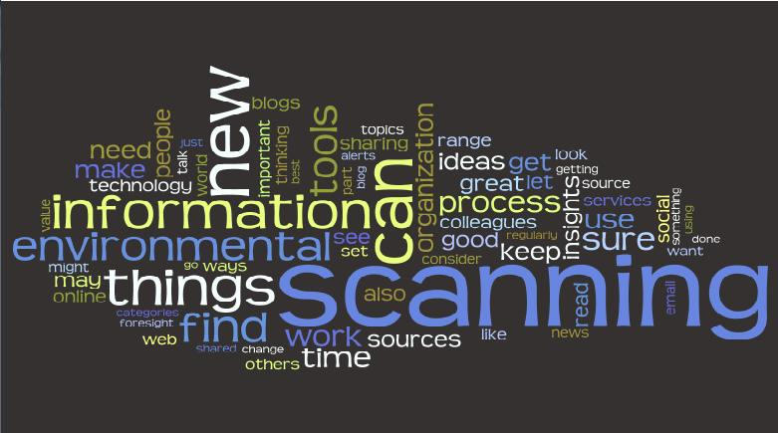
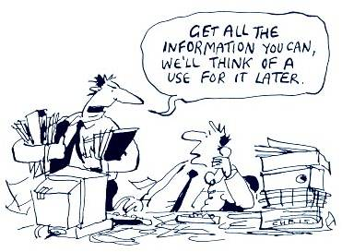

Slide 62

How Can Managers Use Environmental Scanning?
Competitor Intelligence – is the process of gathering information about competitors that allows managers to anticipate competitors’ actions rather than merely react to them.
It seeks basic information about competitors,
Who are they? What are they doing? How will what they’re doing affect us?
Competitor Intelligence – is not corporate espionage!
It is suggested that much of the competitor information that managers need, to make crucial strategic decisions, is available to the public.

Slide 63
How Can Managers Use Environmental Scanning?
Sources of Competitor Intelligence information include;
promotional material, press releases,
reports filed with government bodies,
recruitment ads, newspaper reports etc.
Purchasing access to databases,
as well as searches on the internet can provide key information.,
Global information can be garnered through subscriptions to news services.
Managers should ensure that information gathering is legal and ethical.
The theft of proprietary materials or trade secrets is illegal, and delineated by the Economic Espionage Act.
A manager at a competitive intelligence firm claims that 99.9% of intelligence gathering is legal – some companies will go to any measure to get information – perhaps in unethical means (and occasionally illegal means) to get competitor intelligence. (Bergsman, 1996)

Slide 64
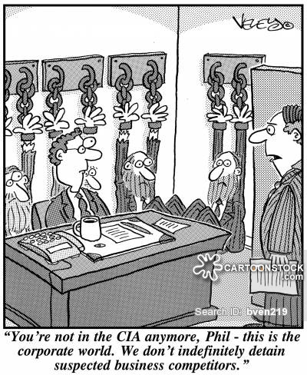

Slide 65


Slide 66
Reference List
American Management Association (2010), “ Mercer Study Shows Workforce Priorities for 2010”, www.amanet.org October 21, 2009
Bergsman, S. (1996), “Corporate Spying Goes Mainstream”, CFO, December
Bresser, R.K. and Bishop, R.C. (1983), “Dysfunctional Effects of Formal Planning: Two Theoretical Explanations” Academy of Management Review, October pp 588 - 599
Clifford, S. and Creswell, J, (2009), “At Bloomberg, Modest Strategy to Rule the World”, New York Times online, November 15., 2009
Drucker, P. (1996) The Executive in Action, Harper Collins

Slide 67
Reference List
Faorclough, G. and Bauerlien, V, (2009), “PepsiCo CEO Tours China to Get a Feel for Market”, Wall Street Journal, July
Ghobadian, A, O’Regan, N. Thomas, H. and Liu, J. (2008), “Formal Strategy Planning, Operating Environment, Size Sector and Performance” Journal of General Management, pp. 1 -19.
McDonalds (2010) Proxy Statement (www.mcdonalds.com) May 24, 2010
Molz, R. “How Leaders Use Goals” Long Range Planning, October P.91
Riberio. J., (2009) “Wipro sees drop in outsourcing revenue” Bloomberg Business Week Online, July 22

